Slide 1
B-Trees

Slide 2
B-Tree Characteristics
In a B-tree each node may contain a large number of keys
B-tree is designed to branch out in a large number of directions and to contain a lot of keys in each node so that the height of the tree is relatively small
Constraints that tree is always balanced
Space wasted by deletion, if any, never becomes excessive
Insert and deletions are simple processes
  Complicated only under special circumstances
  -Insertion into a node that is already full or a deletion from a node makes it less then half full

Slide 3
B-tree of Order 5 Example
All the leaf nodes must be at same level
All nodes except root must have at least m/2 keys and maximum of m-1 keys.
All node except leaf node have keys one less than number of children.
All the key values within a node must be in Ascending Order.

Slide 4
B-Tree Insertion
B-tree starts with a single root node (which is also a leaf node) at level 0.
Once the root node is full with m – 1 search key values and when attempt to insert another entry in the tree, the root node splits into two nodes at level 1.
Only the middle value is kept in the root node, and the rest of the values are split evenly between the other two nodes.
When a non-root node is full and a new entry is inserted into it, that node is split into two nodes at the same level, and the middle entry is moved to the parent node along with two pointers to the new split nodes.
If the parent node is full, it is also split.
Splitting can propagate all the way to the root node, creating a new level if the root is split.

Slide 5
B-Tree Deletion
If deletion of a value causes a node to be less than half full, it is combined with it neighboring nodes, and this can also propagate all the way to the root.
- Can reduce the number of tree levels.

Slide 6
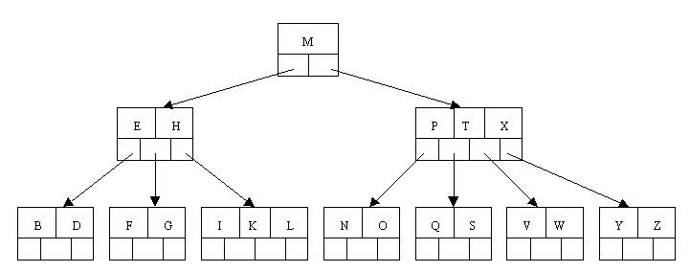

Slide 7

B-Tree Order 5 Insertion
Originally we have an empty B-tree of order 5
Want to insert C N G A H E K Q M F W L T Z D P R X Y S
Order 5 means that a node can have a maximum of 5 children and 4 keys
All nodes other than the root must have a minimum of 2 keys
The first 4 letters get inserted into the same node

Slide 8
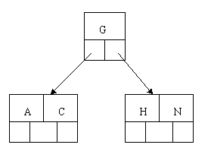
B-Tree Order 5 Insertion Cont.
When we try to insert the H, we find no room in this node, so we split it into 2 nodes, moving the median item G up into a new root node.

Slide 9
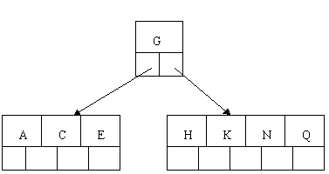
B-Tree Order 5 Insertion Cont.
Inserting E, K, and Q proceeds without requiring any splits

Slide 10
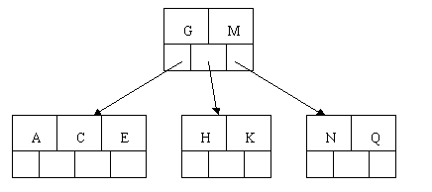
B-Tree Order 5 Insertion Cont.
Inserting M requires a split

Slide 11
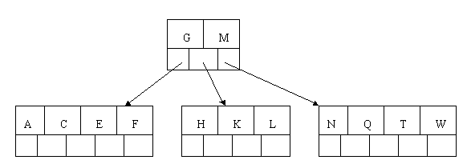
B-Tree Order 5 Insertion Cont.
The letters F, W, L, and T are then added without needing any split

Slide 12
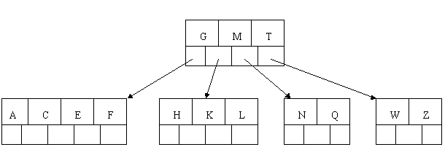
B-Tree Order 5 Insertion Cont.
When Z is added, the rightmost leaf must be split. The median item T is moved up into the parent node

Slide 13
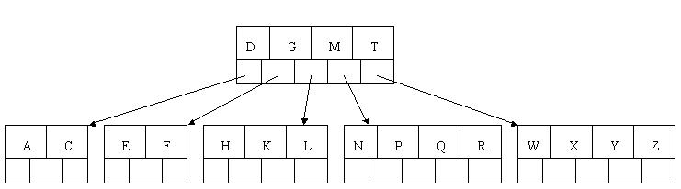
B-Tree Order 5 Insertion Cont.
The insertion of D causes the leftmost leaf to be split. D happens to be the median key and so is the one moved up into the parent node.
The letters P, R, X, and Y are then added without any need of splitting

Slide 14
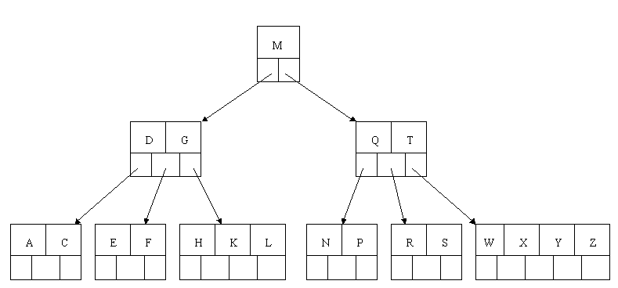
B-Tree Order 5 Insertion Cont.
Finally, when S is added, the node with N, P, Q, and R splits, sending the median Q up to the parent.
The parent node is full, so it splits, sending the median M up to form a new root node.

Slide 15
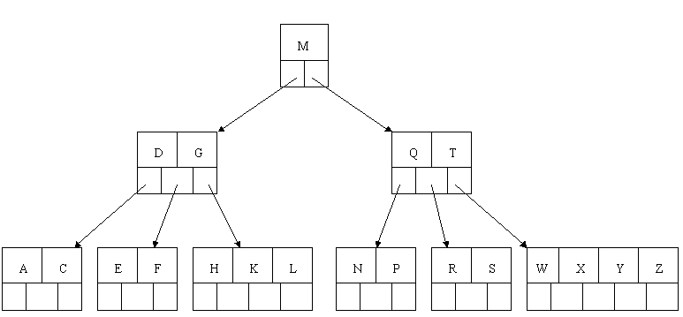
B-Tree Order 5 Deletion
Initial B-Tree

Slide 16
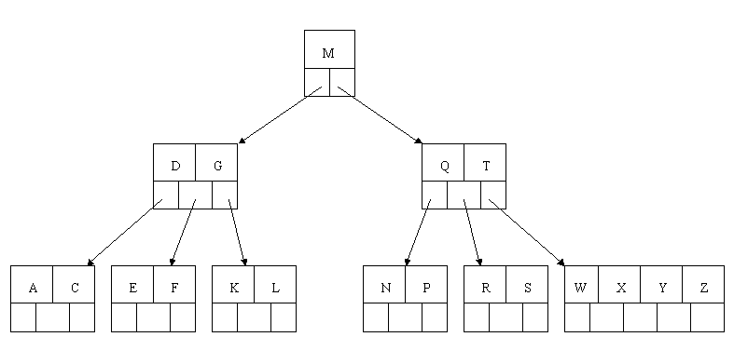
B-Tree Order 5 Deletion Cont.
Delete H
Since H is in a leaf and the leaf has more than the minimum number of keys, we just remove it.

Slide 17

B-Tree Order 5 Deletion Cont.
Delete T.
Since T is not in a leaf, we find its successor (the next item in ascending order), which happens to be W.
Move W up to replace the T. That way, what we really have to do is to delete W from the leaf .

Slide 18
B+- Tree Characteristics
Data records are only stored in the leaves.
Internal nodes store just keys.
Keys are used for directing a search to the proper leaf.
If a target key is less than a key in an internal node, then the pointer just to its left is followed.
If a target key is greater or equal to the key in the internal node, then the pointer to its right is followed.
B+ Tree combines features of ISAM (Indexed Sequential Access Method) and B Trees.

Slide 19
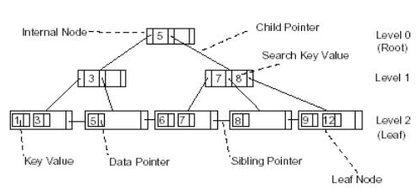
B+- Tree Structure

Slide 20

B+- Tree order 3 Insertion
Insert value 5, 8, 1, 7
Inserting value 5
Since the node is empty, the value must be placed in the leaf node.

Slide 21

B+- Tree Insertion Cont.
Inserting value 8
Since the node has room, we insert the new value.

Slide 22
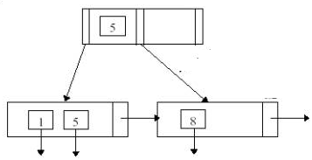
B+- Tree Insertion Cont.
Insert value 1
Since the node is full, it must be split into two nodes.
Each node is half full.

Slide 23
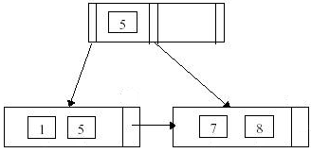
B+- Tree Insertion Cont.
Inserting value 7.

Slide 24
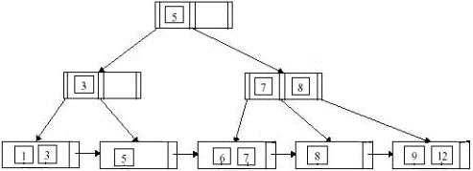
B+- Tree Deletion
Initial Tree

Slide 25
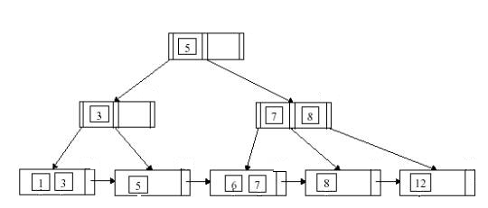
B+- Tree Deletion Cont.
Delete Value 9
Since the node is not less than half full, the tree is correct.

Slide 26
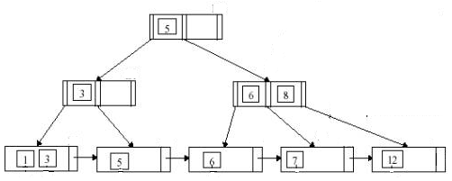
B+- Tree Deletion Cont.
Deleting value 8
The node is less then half full, the values are redistributed from the node on the left because it is full.
The parent node is adjusted to reflect the change.

Slide 27
References
Beginning Database Design By Gavin Powell
Database System Concepts By Silberschatz, Korth, Sudarshan
Fundamentals of Database Systems By Elmasri, Navathe
http://dns.mec.ac.in/notes/ds/bp lus.htm
http://cis.stvincent.edu/swd/btree/btree.html

